Slide 1


SNN Investors Day
Audited Individual Financial Statements as at and for the year ended
December 31, 2022
Bucharest: April 27, 2023
POWERed by people

Slide 2
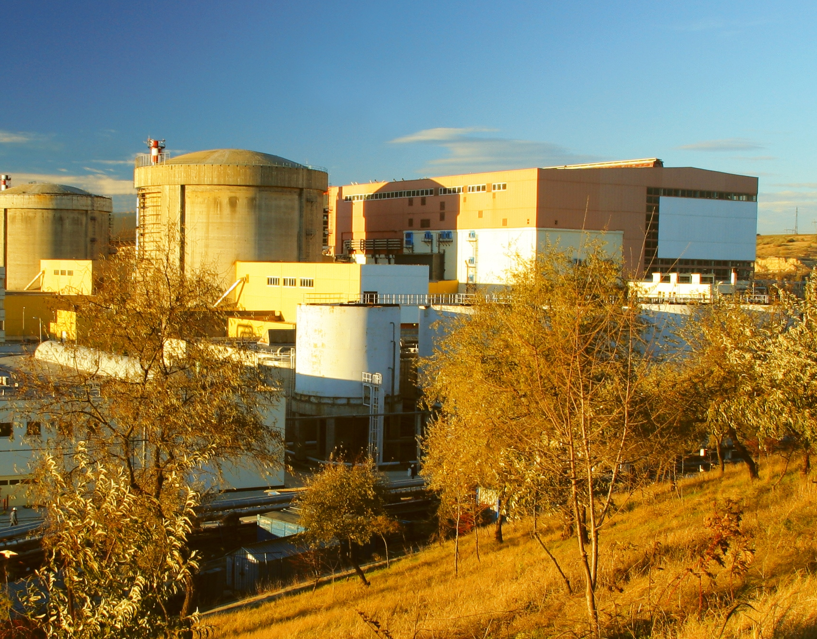
Executive Summary
Financial Highlights
12M 2022 Financial results
Net result evolution
Financial position
Income statement
Final vs Preliminary Income Statement
Sales of electricity
- Sales of electricity evolution
- Sales structure analysis
OPEX
CAPEX
- Main investments
Technical performances
- Radioactive emissions
- Nuclear fuel burn up factor
- Capacity factor
SNN details
- Executive Management
- Investor Relation
- Financial calendar 2023

Slide 3
12M 2022 Financial results highlights
Indicator | Unit | 12M 2022 (audited) | 12M 2021 (audited) | Variation | Q4 2022 (unaudited) | Q4 2021 (unaudited) | Variation | Rectified Budget | Variation
 |  |  |  | (%) |  |  | (%) | 12M 2022* | (%)
 |  | 1 | 2 | 3 = (1-2)/2 | 4 | 5 | 6 = (4-5)/5 | 7 | 8 = (1-7)/7
Quantity of energy sold (w/out PE) | MWh | 10,513,116 | 10,891,017 | -3.5% | 2,812,193 | 2,853,923 | -1.5% | 10,555,246 | -0.4%
Sales of electricity (including thermal energy)** | RON ‘000 | 6,343,640 | 3,103,150 | 104.4% | 1,513,750 | 988,331 | 53.2% | 6,336,501 | 0.1%
Operating expenses | RON ‘000 | 2,942,597 | 1,461,544 | 101.3% | 681,124 | 447,167 | 52.3% | 3,290,730 | -10.6%
EBITDA | RON ‘000 | 3,591,413 | 1,742,336 | 106.1% | 942,352 | 570,281 | 65.2% | 3,144,467 | 14.2%
EBIT | RON ‘000 | 2,986,008 | 1,179,480 | 153.2% | 788,226 | 424,853 | 85.5% | 2,523,833 | 18.3%
Net profit |  | 2,764,423 | 1,036,262 | 166.8% | 825,333 | 395,654 | 108.6% | 2,248,904 | 22.9%
* The Revenue and Expenditure Budget rectified by GSM no. 10/19.10.2022.
** Including thermal energy.
Net profit: 2,764,423k RON (22.9% above Budget 12M 2022 and 166.8% above 12M 2021)

Slide 4
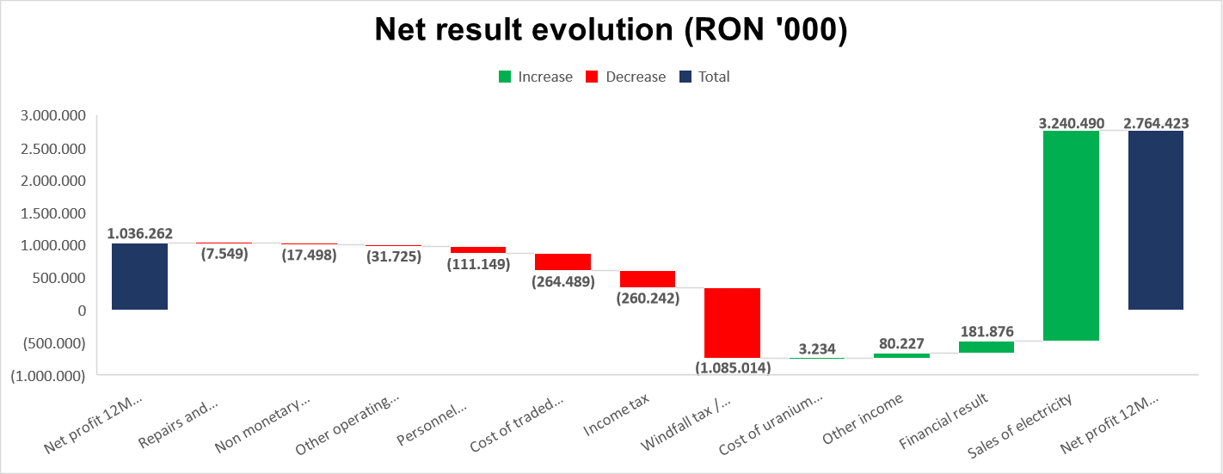
Financial Highlights
- Net result evolution (increased by 166.8%) -
The net profit benefited mainly of the high level of electricity prices, for a smaller quantity as the previous comparative period, which had significant upward impacts on sale of electricity. However, SNN’s profitability was partially offset by the windfall tax/contribution to the Energy Transition Fund (nil in 2021) and also by the correspondent increase in income tax. A negative impact on the profitability had also cost of traded electricity and personnel.

Slide 5
Financial Highlights
- 2022 Financial position -
RON '000 | 31.12.2022 (audited) | 31.12.2021 (audited) | Variation (%)
 | A | B | C = (A - B)/B
Total non-current assets | 6,049,279 | 6,110,845 | (1.0%)
Inventories | 653,200 | 560,150 | 16.6%
Trade receivables | 438,540 | 220,487 | 98.9%
Other financial assets at amortised cost | 140,955 | 87,270 | 61.5%
Cash and cash equivalents (incl. deposits) | 4,510,799 | 2,646,373 | 70.5%
Total current assets | 5,743,493 | 3,514,280 | 63.4%
Total assets | 11,792,772 | 9,625,125 | 22.5%
Share capital and premium | 3,243,416 | 3,243,416 | 0.0%
Prepaid share reserve | 21,554 | 21,554 | 0.0%
Revaluation reserve | 394,370 | 451,743 | (12.7%)
Retained earnings | 6,876,166 | 4,648,549 | 47.9%
Total shareholder's equity | 10,535,505 | 8,365,261 | 25.9%
Long term borrowings | 64,811 | 130,135 | (50.2%)
Long term lease liabilities | 12,831 | 911 | 1309.1%
Provisions for risks and expenses | 174,505 | 245,823 | (29.0%)
Other non-current liabilities | 204,615 | 220,695 | (7.3%)
Total non-current liabilities | 456,762 | 597,564 | (23.6%)
Accounts payable and other liabilities | 655,205 | 424,369 | 54.4%
Current portion of provisions for risks and expenses | 77,041 | 69,541 | 10.8%
Short term lease liabilities | 2,734 | 264 | 935.7%
Current portion of long term borrowings | 65,525 | 168,127 | (61.0%)
Total current liabilities | 800,505 | 662,300 | 20.9%
Total liabilities | 1,257,267 | 1,259,864 | (0.2%)
Total equity and liabilities | 11,792,772 | 9,625,125 | 22.5%
The main variations of the financial position:
Fixed assets - the depreciation recorded during the period exceeds the additions of fixed assets, so that the net value decreases by 1%
Current assets - cash and cash equivalents and bank deposits increase by 1.9 billion RON
Long-term debts – the balance of long-term loans decreases, as the loans are repaid (2 loans fully repaid; EURATOM loan remaining to be repaid, due in 2024)
Current liabilities - their balance includes the solidarity contribution (windfall tax) due for December, paid in January
Equity - the increase in the result carried forward with the profit of the previous period

Slide 6
Financial Highlights
- 2022 Income statement -
* The Revenue and Expenditure Budget was initially approved by GSM no. 3/23.02.2022, subsequently rectified by GSM no. 10/19.10.2022.
** Including thermal energy.

Slide 7
Financial Highlights
- 2022 Final vs Preliminary Income Statement -
Preliminary SF 2022 approved by CA Decision 33/20.02.2023 vs. Final audited SF 2022
Net profit: + 35 million RON
+ 35 million RON Other income - income from the resumption of litigation provision with the Free Nuclear Energy Union 90, increased nuclear risk, based on the final sentence obtained after the date of the preliminary SF, respectively 27.02.2023; the event represents an adjustable subsequent event according to the IAS 10 financial reporting standard
According to Civil Decision no. 63/27.02.2023 pronounced by the Constanta Court of Appeal in file no. 7036/118/2017, having as its object unpaid salary rights, representing the counter value of the increase in professional risk, the appeal filed by the plaintiffs was rejected as unfounded. The solution is definitive. Thus, the Company took back on income the counter value of the provision established for this file, in the amount of 34,987,828 RON;
On 31.12.2022, SNN registered a provision with the CNE Cernavoda Trade Union for a litigation with the same object (increased nuclear risk), in the amount of 89 million, for which the next trial date is 26.05.2023.
- 9.5 million RON Personnel expenses - determined mainly by the actuarial update of the obligations regarding the benefits granted to employees (jubilee bonuses, retirement aid, other benefits) / preliminary SF included the expense with the update of 10 million RON; after obtaining the actuary's report, the net expense was reduced to approximately 1 million RON;
+ 2 million RON Financial expenses - the update of the obligation regarding the benefits granted to employees according to the actuarial report also requires a financial update of this obligation, of approximately 2 million RON;
+ 7 million RON Profit tax, net - the increase in profit determines the increase in profit tax

Slide 8
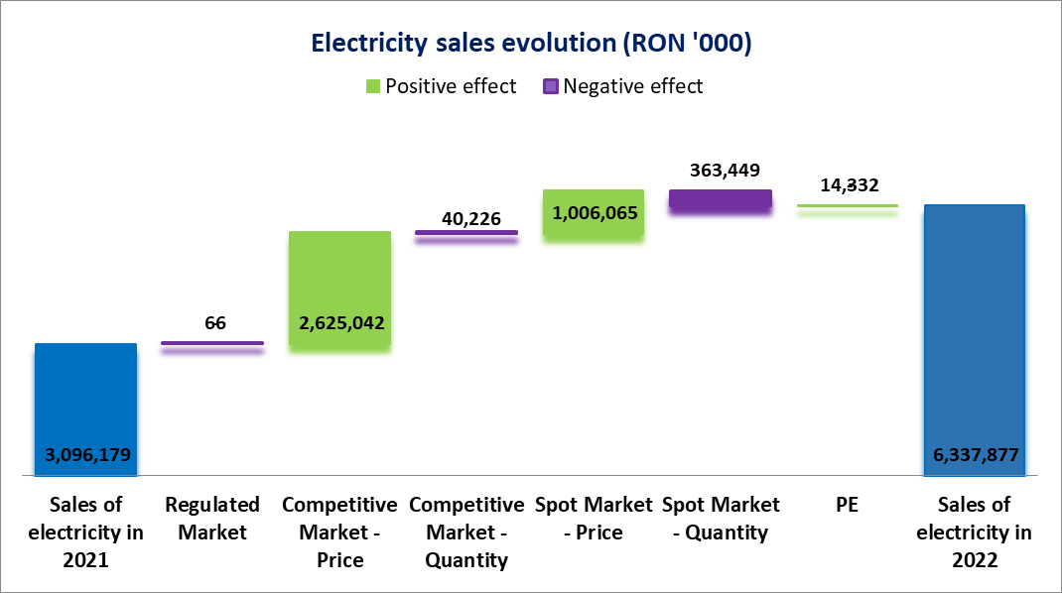
Sales of electricity in 2022 increased by 104.7% compared to 2021
Electricity sales evolution from 12M 2021 to 12M 2022 was determined mainly by increase in weighted average selling price (w/out Tg) of +111.9%, with -3.4% decrease in quantity of electricity sold (-1.3% in Q4’22 vs Q4’21):
Competitive Market: +109.6% increase in price, with -0.8% decrease in quantity sold;
Spot Market: +146.3% increase in price, with -21.5% decrease in quantity sold;
Balancing Market (PE): with +66.6% increase of price, with +21.1% increase in quantity sold.

Slide 9
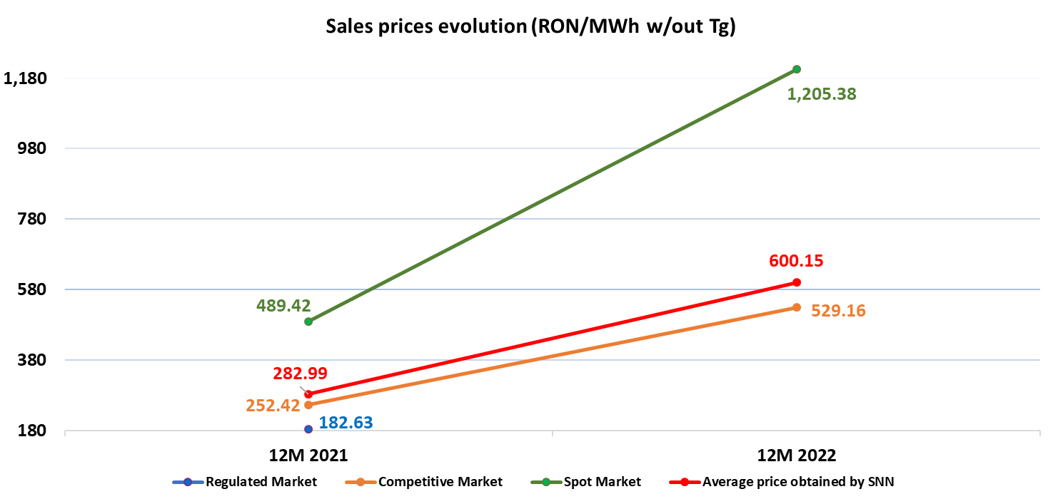
Sales structure analysis 2022 vs. 2021
The sale structure of 2022 is similar to 2021, with minor variation on the regulated market, as a small quantity was sold in January 2021 (delivery in CET hours, the last delivery hour in 2020 being the first in January 2021 (361 MWh, regulated price of 182.63 RON/MWh (w/out Tg)).
The quantities of electricity sold on the Competitive Market represented, in 2022, 89.2% of the total volume of electricity sold, compared to 86.8% recorded in the same period of 2021. The average selling price during this period was 529.16 RON/MWh (w/out Tg), recording a 109.6% increase compared to the average price recorded in the same period of 2021, of 252.42 RON/MWh (w/out Tg).
On the Spot Market (PZU + PI), in 2022, the quantities of electricity sold represented 10.5% of the total sales volume, compared to 12.9% in the same period of 2021. The average price on spot market, achieved by SNN in 2022 was 1,205.38 RON/MWh (w/out Tg), compared to 489.42 RON/MWh (w/out Tg) in 2021.
Actual vs Budgeted

Slide 10
OPEX
12M 2022 OPEX higher with 75.3% compared to 12M 2021 on the basis of:
  Windfall tax / Contribution to the Energy Transition Fund: representing a tax on the additional income resulting from the difference between the average monthly selling prince of electricity obtained by SNN and the threshold price of RON 450 /MWh, settled at 80%, for the period 1 November 2021 – 31 August 2022, in accordance with art. II of Law 259/29.10.2021 and calculated based on the methodology established by GEO no. 27/18.03.2022. Starting from September 1, 2022, GEO no. 27/2022 was amended and supplemented by GEO no.119/2022, the calculation method being updated, tax was settled at 100% over the difference between selling prince and 450 RON/MWh for 1 September 2022 – 31 August 2023. In December 2022, new amendments were made on GEO no. 119/2022, changing the calculation method and extending the application period until 31 March 2025 (Law no.357/2022) ;
  Depreciation and amortisation: recorded a significant increase of 7.6% due increased value of assets following the revaluation report @31.12.2021, acquisitions and commissioned new investments;
  Personnel expenses: increased by 25.0% as a result of increased number of employees (10.9% increase of the average no of employees) and also SNN’s commitments, following the salary increase.
  Cost of uranium fuel: a slight decrease of 2.1%, due to decrease in the weighted average cost of fuel bundles, which comprises all cost components;
  ANDR contribution for decommissioning (0.6 EUR/MWh) and for permanent storage of radioactive waste (1.4 EUR/MWh), no notable variation;
  Technological and non-technological water and energy: 8.8% increase due to higher utility prices recorded in 12M 2022.
  Cost of traded electricity: recorded a significant increase of 106.1%, due to:
  Smaller purchases of electricity at a larger prices in 12M 2022, compared to 12M 2021 (increase of 211 mil. RON), to cover contractual obligations during unplanned outage of U1 in 12M 2022. The total amount of electricity purchased in 12M 2022 was 290,029 MWh (12M 2021: 454,062 MWh), at an average price of 1,291.03 RON/MWh (12M 2021: 359.79 RON/MWh).
  Increase in expenses with imbalances of 53 mil. RON: these expenses represent the equivalent of energy received from balancing market mainly due to differences in notified quantities vs. delivered. The total amount of electricity purchased in 12M 2022 was 64,327 MWh (12M 2021: 93,442 MWh), at an average price of 2,165.51 RON/MWh (12M 2021: 919.13 RON/MWh).
  Electricity transmission expenses: recorded a significant increase of 69.8% due to the increase in the level the transmission tariff into the grid (form 1.30 RON/MWh in 12M 2021 to 1.49 RON/MWh in the first quarter of 2022 and 2.53 RON/MWh from the second quarter of 2022 ).
  Cost with spare parts, repairs and maintenance: recorded an overall increase, correlated with the repairs and maintenance program and with the needs in 2022.

Slide 11
CAPEX
Capital expenditure of SNN in 2022:
561.4 mil. RON in 12M 2022 (in 12M 2021: 319.7 mil. RON) out of total investment program of 609.2 mil. RON.
Target level of 60% for 12M 2022 has been exceeded
CAPEX Program [thousand RON] | Budget 2022 rectified*) | Degree of completion 31.12.2022 |  | Budget 2021**) | Degree of completion 31.12.2021
Ongoing investments | 409,585 | 390,846 | 95.4% | 211,855 | 189,364 | 89.4%
Investments made on tangible assets | 100,694 | 77,687 | 77.2% | 86,756 | 84,935 | 97.9%
Equipments | 98,941 | 92,875 | 93.9% | 58,164 | 45,380 | 78.0%
Total value of investment program | 609,220 | 561,408 | 92.2% | 356,774 | 319,679 | 89.6%
*) Approved through GSM no. 10/19.10.2022 **) Approved through GSM no. 11/28.09.2021

Slide 12
CAPEX
- Aspects related to main investments and long term strategic projects -
  Unit 1 Refurbishment:
  By Extraordinary General Meeting Decision no. 4/23.02.2022, Shareholders of SNN approved the investment decision in the project for refurbishing Unit 1 of Cernavoda NPP. The version approved by the SNN shareholders included project amendments which provide, in addition to Scenario 1, an increase in the nuclear safety margins of the plant and take into account the new trends in increasing the robustness in terms of nuclear safety. The current cost for the implementation of Scenario 2 Enhanced Safety is of about 1.85 billion Euros, without taking into account the financing costs and the inflation rate update on the date when the refurbishment contract of Unit 1 of Cernavoda NPP is going to be signed.
  With the approval of the investment decision, SNN goes into the second phase of the project, namely ensuring the financial resources for the implementation of the Project for the Refurbishment of U1, preparing the performance of the activities that have been identified and defined for the refurbishment in Phase 1 and obtaining all the necessary approvals and authorizations for the implementation of this project.
    Increase of the Production Capacity Project:
    By Extraordinary General Meeting Decision no. 7/10.08.2022, SNN’s shareholders approved the continuations of Cernavoda NPP Units 3 and 4 Project, and adopted the Preliminary Investment Resolution and the advancement to Stage II – Preliminary Stages. SNN’s shareholders also approved to finance Energonuclear subsidiary with 185 mil Euro, in form of either a share capital increase or as a loan.
    During the United Nations Conference on Climate Change (COP27) which took place in November 2022, the US Exim Bank announced the issuance of two letters of interest for the financing of pre-project technical services provided by the US in connection with the Unit 3 and 4 project from Cernavoda. Based on the preliminary information presented, EXIM will be able to consider financing up to $50 mil for pre-project technical services as part of the Engineering Multiplier Program (EMP) and up to $3 billion for engineering and project management services.
    In December 2022, the Government of Romania, at the proposal of the Ministry of Energy, approved the draft law on the signing of the support agreement between the Romanian state and SNN. for the project of Units 3 and 4 Cernavodă. The Law was adopted on March 13.
    Small Modular Reactors
    On November 15, 2022, a Memorandum of Understanding (MoU) was signed between RoPower Nuclear SA and Donalam SRL, part of AFV Beltrame Group, European leader in steel production, at the IAEA Atoms for Climate pavilion at COP 27. Objective of the Memorandum of Understanding is to explore opportunities for cooperation and investment in support of the development of the first SMR project in Romania, which could have a great impact in the realization of green steel production in Romania. On the same occasion, the two companies joined the United Nations 24/7 Carbon Free Energy Compact, committing to the UN's 24/7 principles in support of the UN's goal of accelerating the electricity system, mitigating climate change and to ensure access to clean energy at affordable prices.
    On December 28, 2022, the contract for the Front-End Engineering and Design (FEED) works was signed between NuScale Power LLC and the Romanian company RoPower Nuclear S.A., marking an important step towards the implementation of a NuScale VOYGR™ power plant with small modular reactors ( SMR) in Romania.

Slide 13
Radioactive emissions U1+U2 (μSv)
Total 2022: | Anual limit:
7.9 | 250
CNCAN authorized limit = 100 μSv/year/unit + 50 μSv/year DICA
Legal limit for population (as per Radioprotection Norm NSR01) = 1,000 μSv/year

Slide 14
Nuclear fuel burn up factor (MWh/KgU)
(Cumulated 2022: 173.6/Project estimated: min. 156)

Slide 15
CANDU Technology Unit performance U1 + U2 (%) Capacity Factor
(Cumulated 2022: 90.01%)

Slide 16
Disclaimer
This documents was prepared by Nuclearelectrica team only for this presentation purpose. This document cannot be understood anyway as an offer to sell/buy Nuclearelectrica shares.
The document content is only for your information and all the statements other than statements of historical facts included in this document are referring to intentions, expectations, estimates or future projections of Nuclearelectrica and its management. All statements other than statements on historical facts included in this document, including, without limitation those regarding the Company’s financial position, business strategy, plans, and objectives of management for future operations, are forward-looking statements. Such forward-looking statements involve known and unknown risks, uncertainties and other factors which may cause the actual results, performance or achievements of the Company, or industry results, to be materially different from any future results, performance or achievements expressed or implied by such forward-looking statements. Such forward-looking statements are based on numerous assumptions regarding the Company’s present and future business strategies and the environment in which the Company will operate in the future and speak only as of the date of this document. As a result of these risks, uncertainties and assumptions, you should in particular not place reliance on these forward-looking statements as a prediction of actual results or otherwise.
Neither Nuclearelectrica not its management, employees or consultants will be responsible for the accuracy and completeness of the information and statements contained in this document and in any circumstances the content of this presentation, in particular, cannot be interpreted as any assurance or guarantee, offered by Nuclearelectrica or its representatives.
This document does not purport to contain all information that may be necessary in respect of the Company or its shares and in any event each person receiving this document needs to make an independent assessment. For an independent assessment in taking any decision regarding Nuclearelectrica, the Company recommends the public documents and information endorsed by Financial Supervisory Authority and Bucharest Stock Exchange.
This document is not directed at, or intended for distribution to or use by, any person or entity that is a citizen or resident or located in any locality, state, country or other jurisdiction where such distribution, publication, availability or use would be contrary to law or regulation or which would require any registration or licensing within such jurisdiction.

Slide 17
SNN Investor Relation
2023 Financial calendar
Event | Date
Publication of the First Quarterly Report 2023 (January - March) Conference call Financial analysts, investment advisors, brokers and investors. | 12 May 2023 (Friday) Hour of the conference call: 16:00 Romania's time
Publication of the First Half - Year Report 2023 (January - June) Conference call Financial analysts, investment advisors, brokers and investors. | 14 August 2023 (Monday) Hour of the conference call: 16:00 Romania's time
Publication of the Third Quarterly Report 2023 (January - September) Conference call Financial analysts, investment advisors, brokers and investors. | 13 November 2023 (Monday) Hour of the conference call: 16:00 Romania's time
S.N. Nuclearelectrica S.A. (SNN)
www.nuclearelectrica.ro
Stock: ISIN ROSNNEACNOR8
Tel.: +40 21 203 82 00
E-mail: investor.relations@nuclearelectrica.ro
Executive Management
COSMIN GHITA - CEO
Cosmin.Ghita@nuclearelectrica.ro
DAN NICULAIE - FARANGA - CFO
Dan.Niculaie@nuclearelectrica.ro

Slide 18
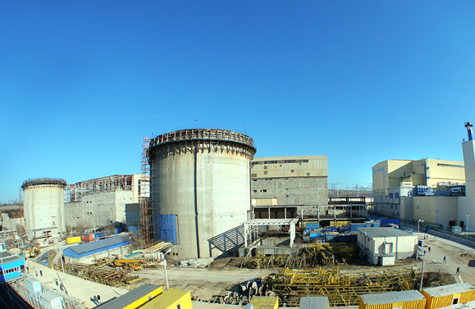
Thank you!

